Slide 1



ICTC Training program

Slide 2
Versioning
Version | Date de version | Auteur / Contributeurs | Nature des modifications
3.2 | 2017-06-08 | Carol Andrea Guerrero Mickaël Brard | Initial diffusion
CC-BY-NC-SA

Slide 3
Summing-up
Integrated Business Process with Odoo
Purchases
CRM
Suppliers
Manufacturing
Business Processes
Customers
Inventory
Sales
Human Resources
Accounting
Projects
Employees
CC-BY-NC-SA

Slide 4











Summing-up / ERP Modules
CRM
Sales
Purchases
Inventory
Sales team Management
Customer Management
Lead Management
Opportunities Management
Help Desk & Support
Quotation Management
Order Management
Invoice Management
Products & Pricing Management
Purchasing Management
Replenishment
Supplier Management
Products / Services Management
Inventory Management
Logistics – In & Out Bound
Stock Allocation
Warehouse & Locations Management
Manufacturing
Accounting
Projects
Human Resources
Production Order
Bill of Material
Routing
Quality & Maintenance
Lean Manufacturing
Account Receivables
Account Payables
Bank & Cash Management
Business Analytics
Set taxes
Cost Accounting
Budget & Forecast
Business Strategy
Ressource & Capacity Planning
Executive Dashboard & Control
Key Projects Metrics
Timesheet & Activity tracking
Expense Management
Recruitment
Employees
Performance Management
Compensation
Training & Development
Attendance & Leaves
Expenses
CC-BY-NC-SA

Slide 5
Project Management

Slide 6
Project Management
Project Management Strategies
1. Identify value
2. Definition & Planning
3. Execution & Control
4. Close-Out & Support
Management Improvement
Increase Competitive
Advantage
New Product / Service
Development
Restructuring
Scope
Quality
Shedule & Deadlines
Budget
Ressources
Risk
Methodology & Deliverables
Project Completion
Reporting Results &
deliverables
Training
Change Management
Continuous Improvement
Cost
Time
Quality
Communications
Procurement
Risk
Human Resources
CC-BY-NC-SA

Slide 7
Project Lifecycle - Overview
« The life cycle is the only thing that uniquely distinguishes projects from non-projects »
Patel & Morris (The Role of the Project Life Cycle in Project Management : A literature review by R. Max Wideman)
Initiating Process
Planning Process
Executing Process
Closing Process
Project Definition
Detailed Planning
Monitoring & Control
Project Review
CC-BY-NC-SA

Slide 8
Set up a new project

Slide 9
Exercise : Creating a new project
Canadian Colors wants to potentiate its virtual distribution channel to increase sales by 40%. For this, the Marketing Director as the Project Manager will be in charge of making the redesign of the website.
The project will be developed under the following guideline :
CC-BY-NC-SA

Slide 10
Exercise : Creating a new project
30 min
TO DO :
Create new stages : TO DO, IN PROGRESS, and DONE
According to the project plan, to create the tasks for this project
Fill out each task with a little description, planned hours and estimated execution time
Note : the system assigns you as the person responsible for executing the tasks by default. Do not change this parameter.
CC-BY-NC-SA

Slide 11
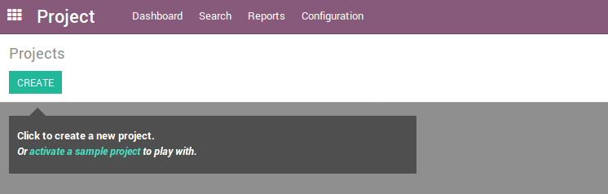
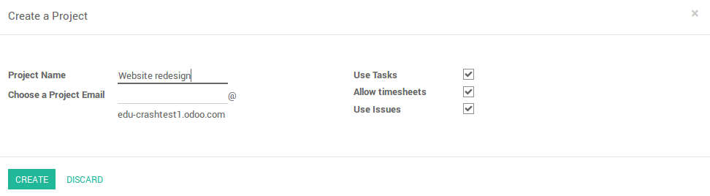
Projects – New Project
CC-BY-NC-SA

Slide 12

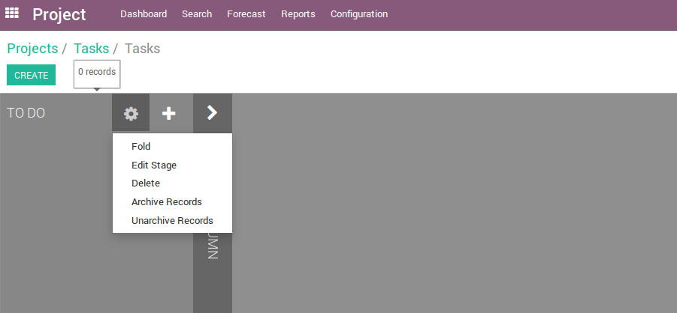
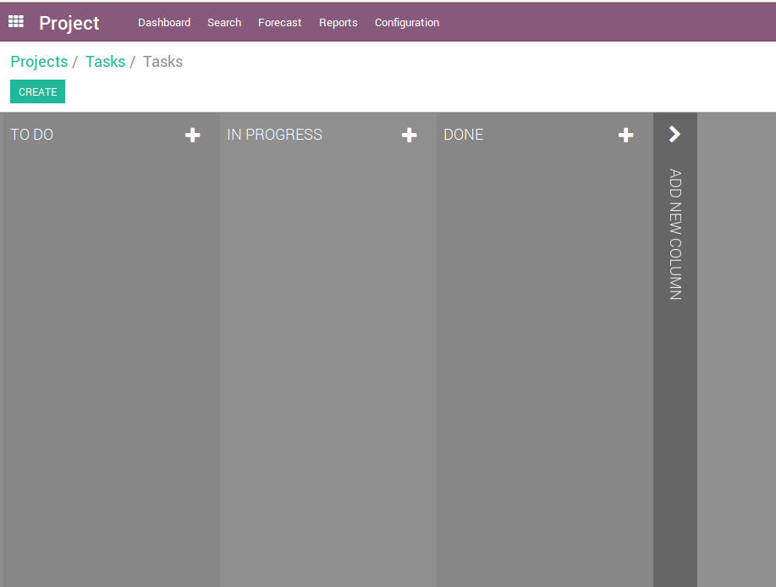
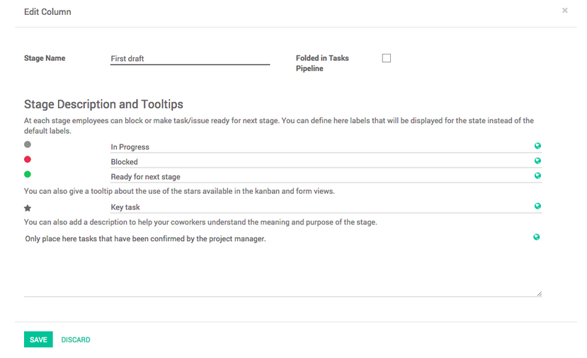
Projects – Project Stages
1
2
Creating new stages
Add & rearrange stages
CC-BY-NC-SA

Slide 13
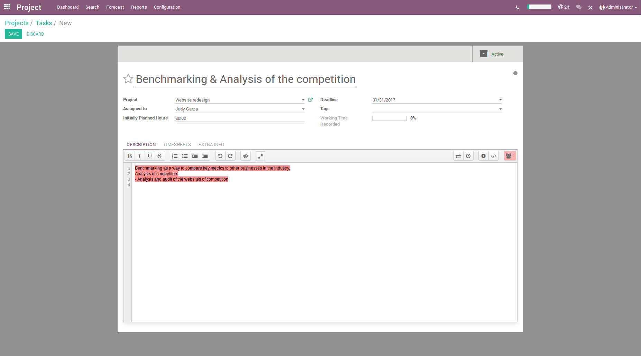
Projects – Project Tasks
CC-BY-NC-SA

Slide 14
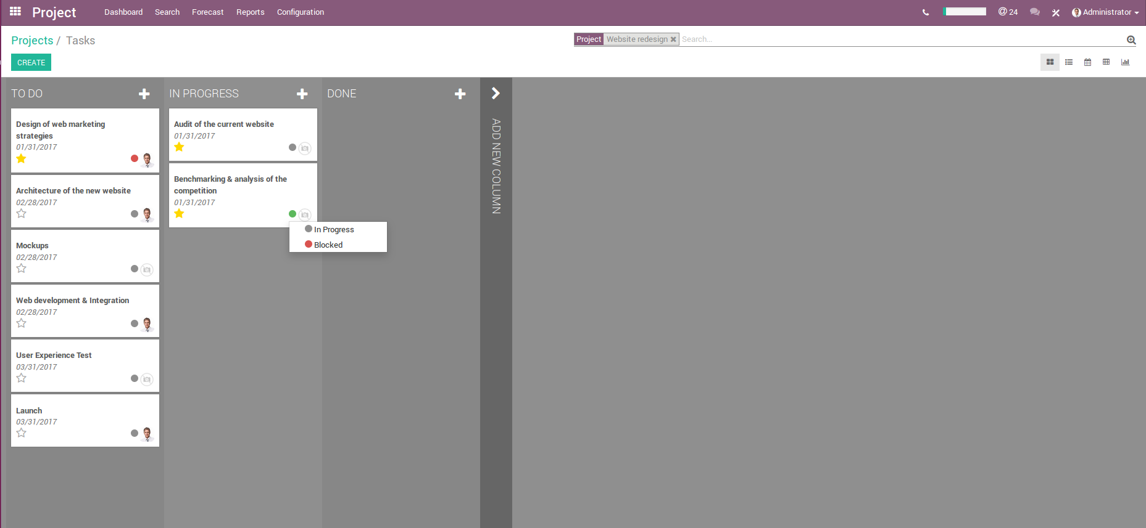
Projects – Overview of activities
1
2
4
3
1. Internal search engine
2. Kanbas View
3. Custom states
4. Sort tasks by priority
CC-BY-NC-SA

Slide 15
Record time spent

Slide 16
Projects – Recording timesheets
Odoo allows you to record the time spent per employee and per project, for simple reports as well as for direct invoicing to the customer.
In Odoo you have two options to record the time spent of employees :
From the projects application
From the timesheets application
CC-BY-NC-SA

Slide 17
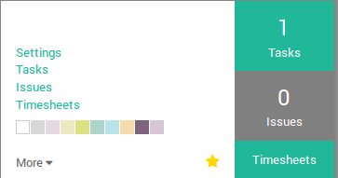
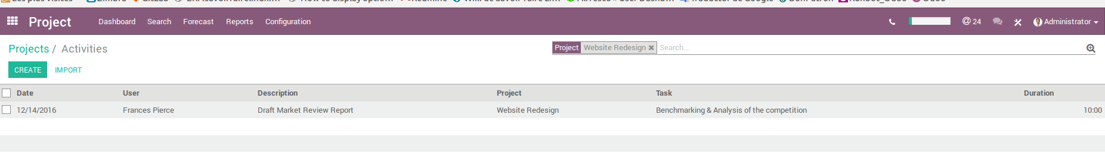
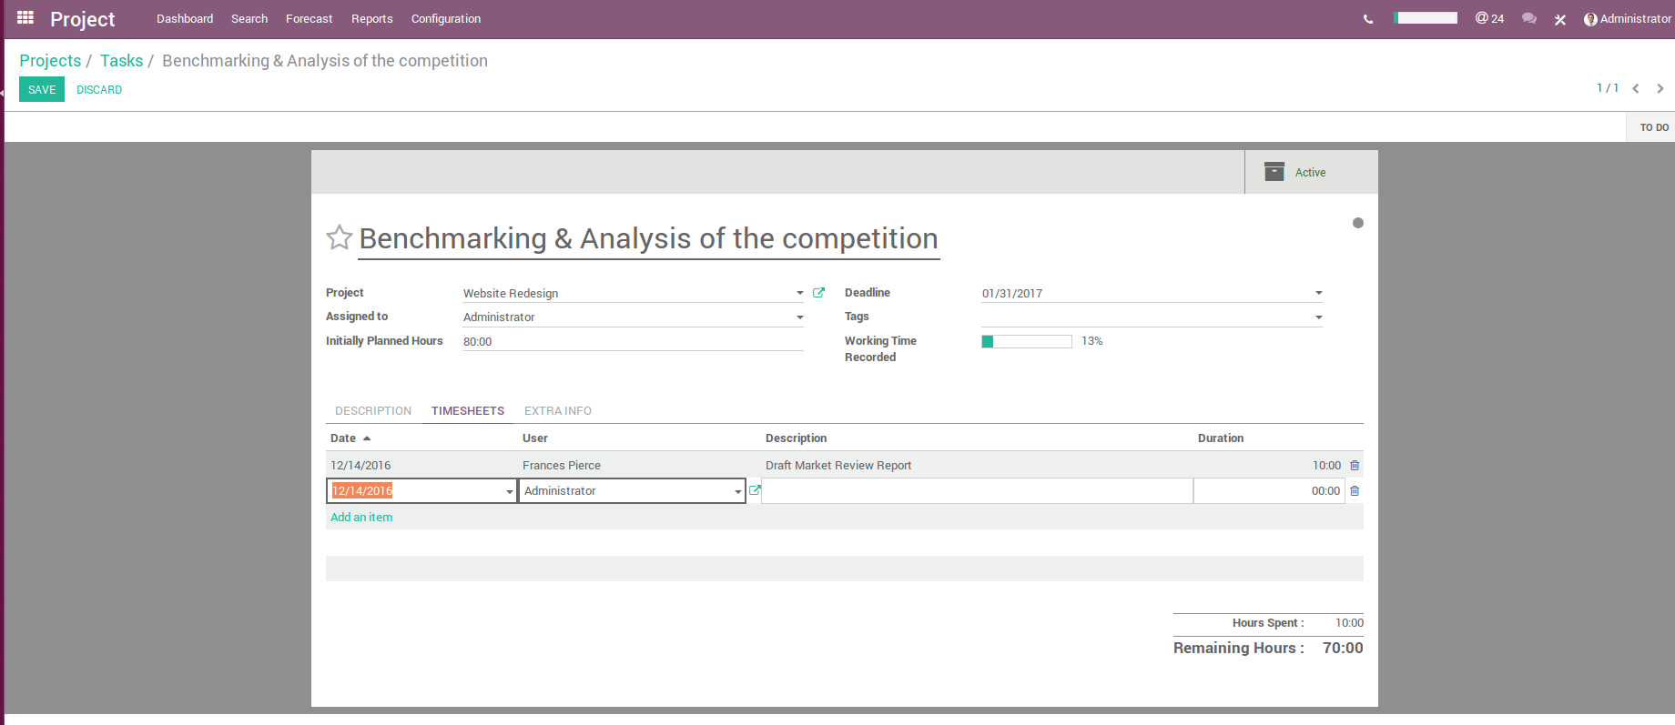
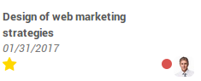
Projects – Recording timesheets
Settings Timesheets Activate timesheets on issues
1
Recording time in a project
2
Recording time in a task
CC-BY-NC-SA

Slide 18

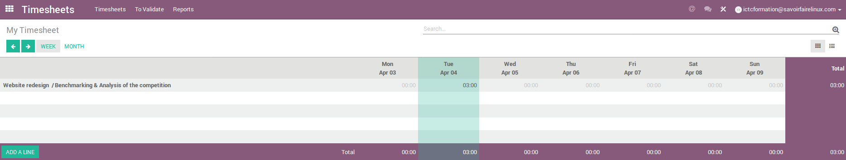
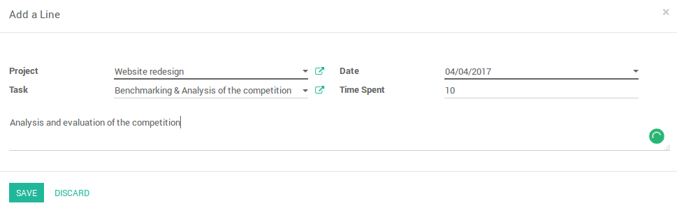
Projects – Recording timesheets
CC-BY-NC-SA

Slide 19
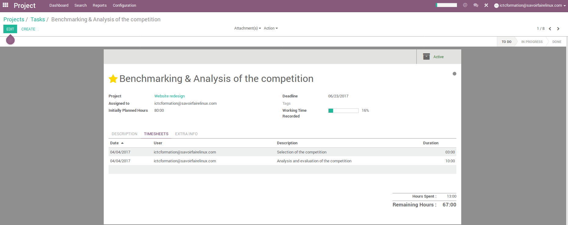
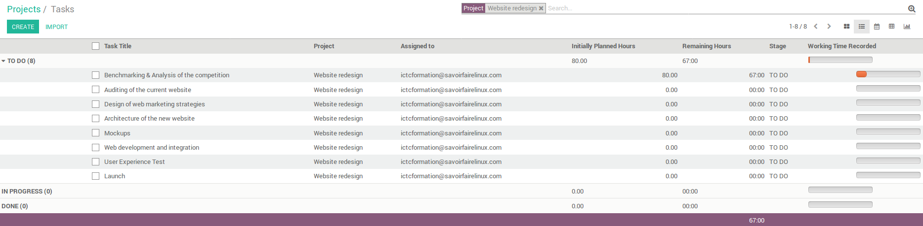
Projects – Working Time Progress
CC-BY-NC-SA

Slide 20
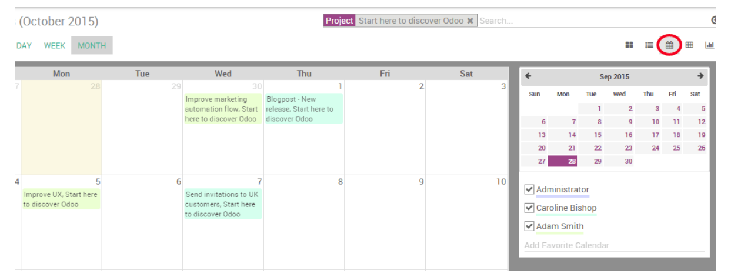
Projects – Deadlines with the Calendar view
If you add a deadline in tasks, they will appear in the calendar view. As a manager, this view enables you to keep an eye on all deadlines in a single window.
January 2017
Feb 2017
All the tasks are tagged with a color corresponding to the employee assigned to them.
Filter deadlines by employees by ticking the related boxes on the right of the calendar view
CC-BY-NC-SA

Slide 21
Exercise : Record time spent
20 min
TO DO :
As Project Manager, take some tasks and record time spent on each one
Check the overall progress of the project according to the records that you has created
Note : the system assigns you as the person responsible for executing the tasks by default. Do not change this parameter.
CC-BY-NC-SA

Slide 22
Project Management & Sales

Slide 23
Create tasks from sales order
Sales
Department
Selling services
Sales Order
Services = Tasks
Services
Department
A task is an activity that needs to be accomplished within a defined period of time
CC-BY-NC-SA

Slide 24




Integration with other Odoo Apps
Selling a service
Sales Order
Product Profile (Service)
Tasks
Deadlines
Employees
Record time spend on each job by employee
Service Billing
Payroll
Update calendars automatically
Summary of time worked in a job
CC-BY-NC-SA

Slide 25
Exercise : Record time spent
30 min
Canadian Colors Inc. offers custom decoration and renovation service to home and industrial improvement projects. This service is offered to customers in stores.
A customer bought an Epoxy application service and floor renovation for your factory. This service is sold in pack of 36 hours at $9.000. The price is fixed and charged initially. But the company wants to keep track of the delivery of this service per hour worked.
On the sale order, the service will trigger the creation of a task from which contractors will record timesheets and, if needed, reinvoice the customer according to the overtime and materials spent on the project.
CC-BY-NC-SA

Slide 26
Exercise : Record time spent
TO DO :
Create and set up the service in order to generate a task every time it will be sold. In the Sales module, create a new product with the following setup :
Name : Renovation Service
Product Type : Service
Unit of Measure : Hours
Internal category : All / Professional services
Invoicing policy : You can set up invoice policy either on ordered quantity or on delivered quantity. You can easily follow the amount of hours that were delivered and/or invoiced to your client.
Track Service : Create a task and track hours, as your product is a service invoiceable by hours you have to set the units of measures of the product to hours as well.
Customer Lead Time : 3 days (36 hours)
CC-BY-NC-SA

Slide 27
Exercise : Record time spent
TO DO :
Once the product is set up, create a quotation or a sale order with the related product. Once the quotation is confirmed and transformed into a sale order, the task will be created. In the Sales module, create a new sales order with the following setup :
Customer : Home Decor – Invent the additional information of this client.
Payment terms : Immediate Payment
A new task will appear in the new sales order and the Project module
Switch from role to contractor, complete the task for this project
Invoice the service to the customer
CC-BY-NC-SA

Slide 28
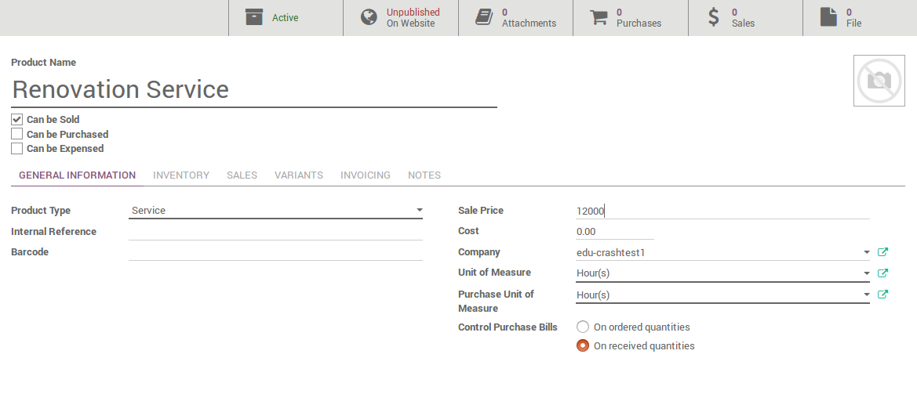
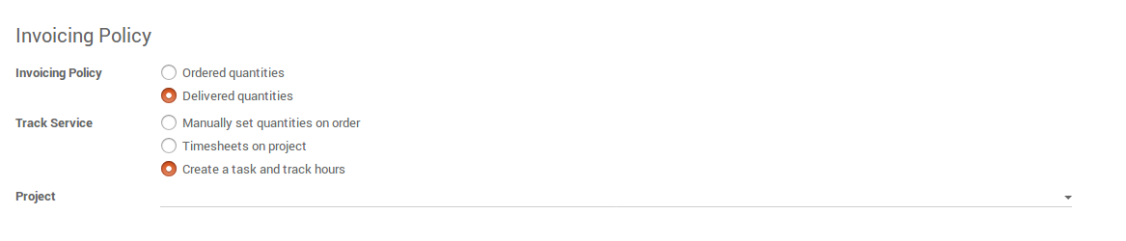
Create and set up a product (service)
Link this task to an existing project or create a new one. Otherwise, you can leave it blank, Odoo will then create a project per so.

Slide 29
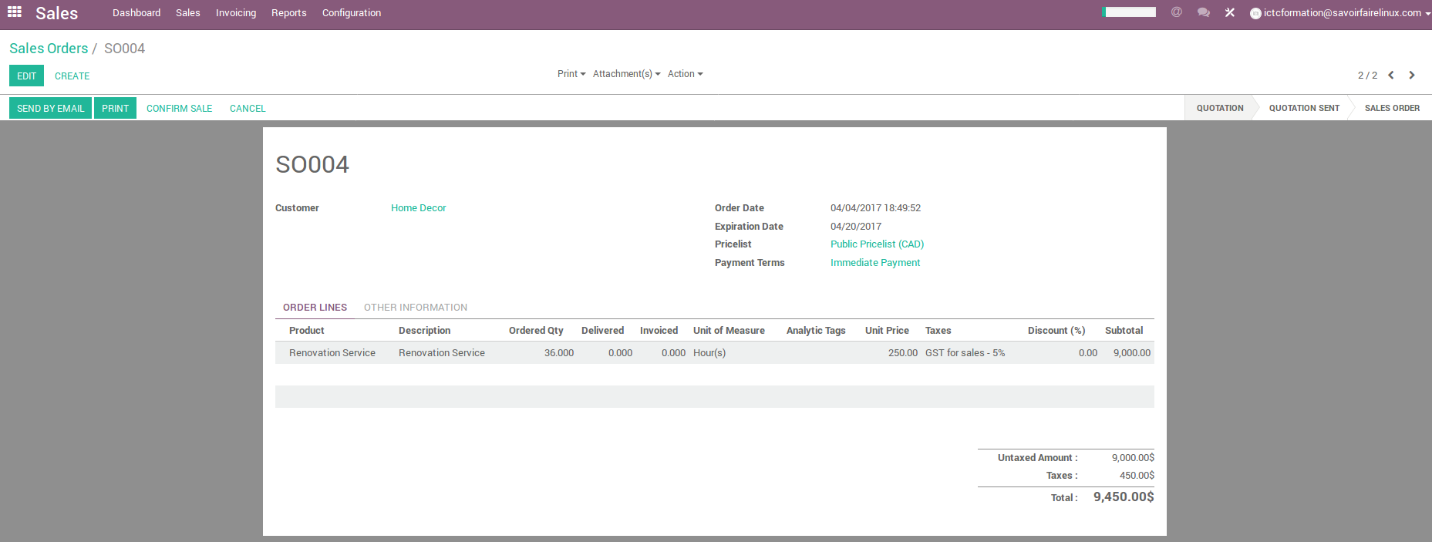
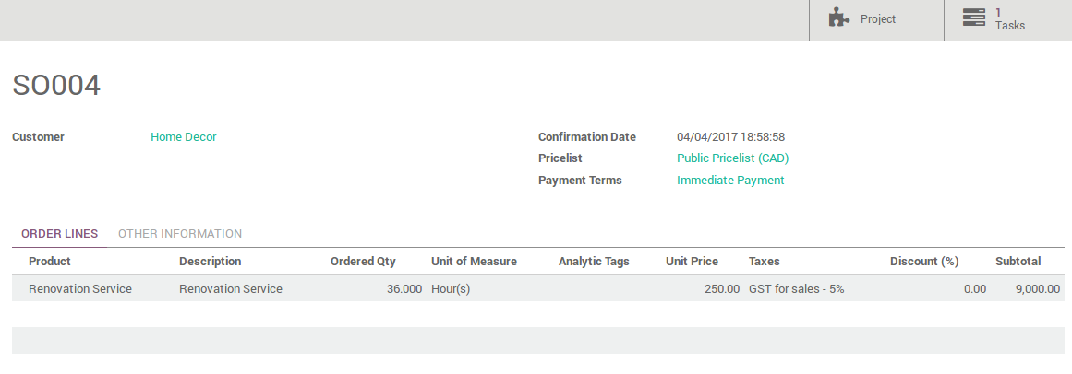
Create the Sales Order
1

Slide 30
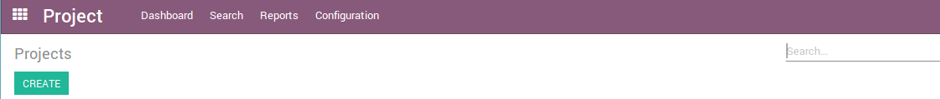

Access the task generated from the sale order
On the task itselft, you will now be able to record timesheets and to invoice customers based on invoicing policy.

Slide 31
Issue Tracking

Slide 32
Projects to handle claims/issues
Odoo offers the opportunity to create dedicated support projects which automatically generate tasks upon receiving an customer support email.
The issue can be assigned directly to an employee
The issue can be treated and closed quickly
CC-BY-NC-SA

Slide 33






Integration with other Odoo Apps
Phone
E-mail
Customer
Create a project for support and issues :
Tasks
Deadlines
Employees
Support
Bug Tracker
Helpdesk
Claims / Issues
Web visit
CC-BY-NC-SA

Slide 34
Exercise : Creating a support project
30 min
Canadian Colors recently implemented a new ERP system. In order to ensure the smooth operation of applications, the company created a new project called "Internal Support" to give an immediate response or technical support of the system.
A work team will provide technical service to each user who records issues manually or via email.
TO DO
Let’s start by simply creating a support project. Create a new project « Internal Support »
Tick the issues box and rename the field as « Bugs ». Also, set up the email « support » to generate issues from this email.
Activate and give visibility to employees on invitation only to follow their claims/issues
Set up to notify employees when an issue will be created and assigned an employee
Set up the workflow : Undefined, Assigned, Analysis, Customer Feedback, close, and cancelled.
Create some support issues manually in this project (e.g. Error during data migration, Cannot open the CRM module, Customized field for Healthcare, etc.)
CC-BY-NC-SA

Slide 35
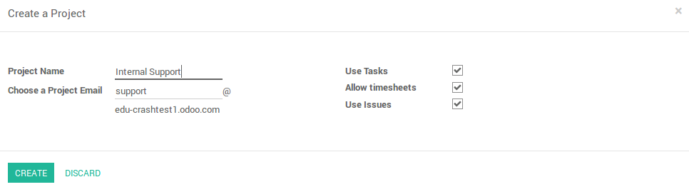
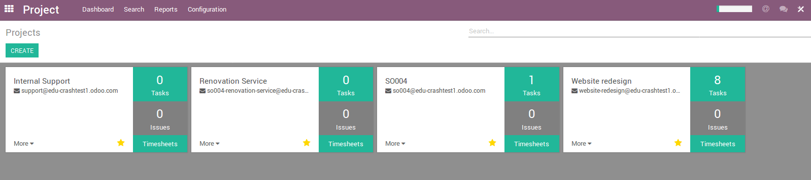
Creating a support project
Settings

Slide 36
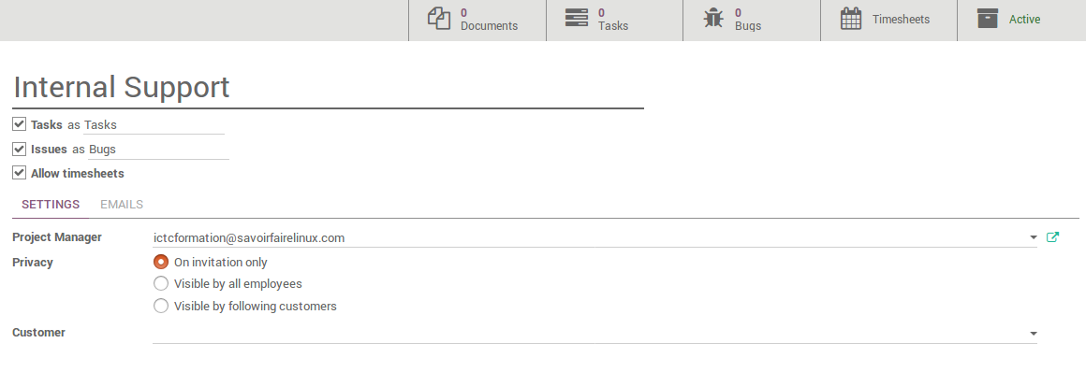
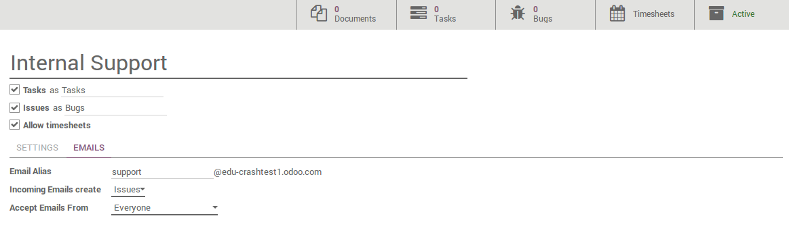
Creating a support project

Slide 37
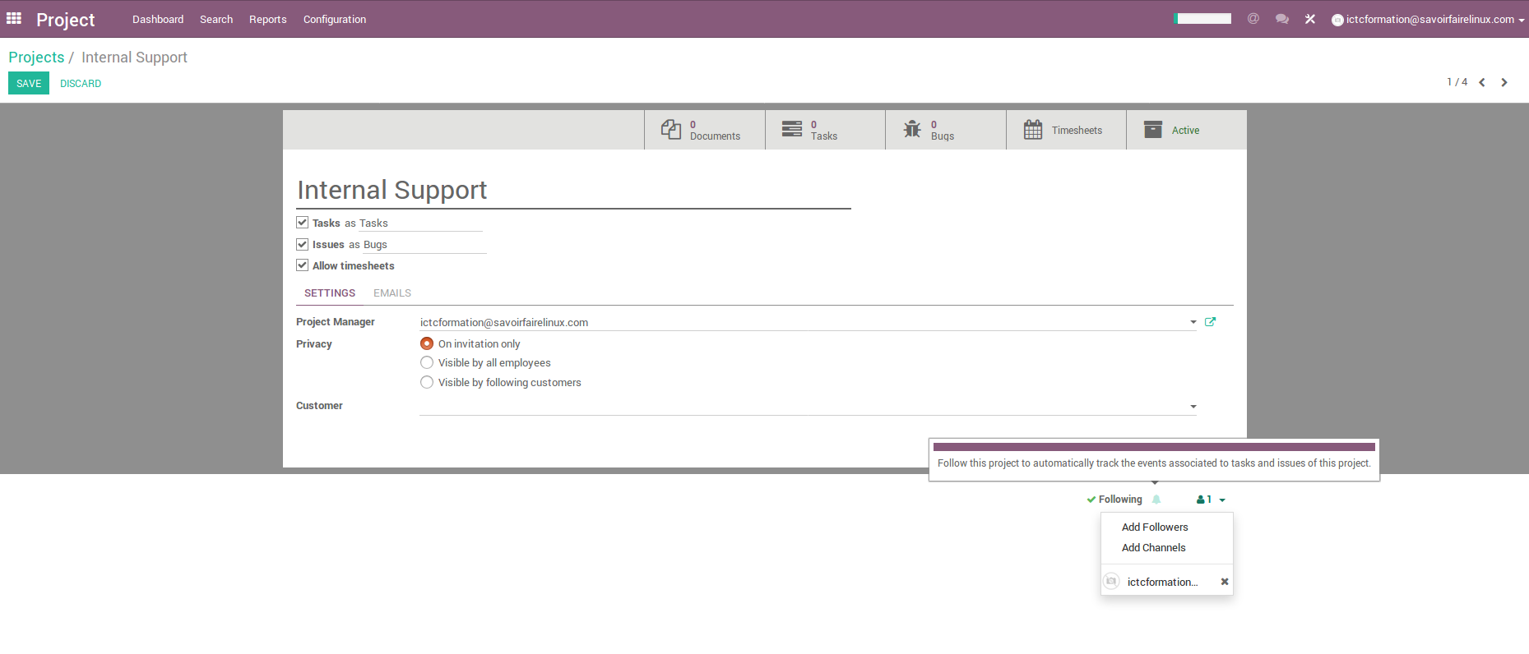
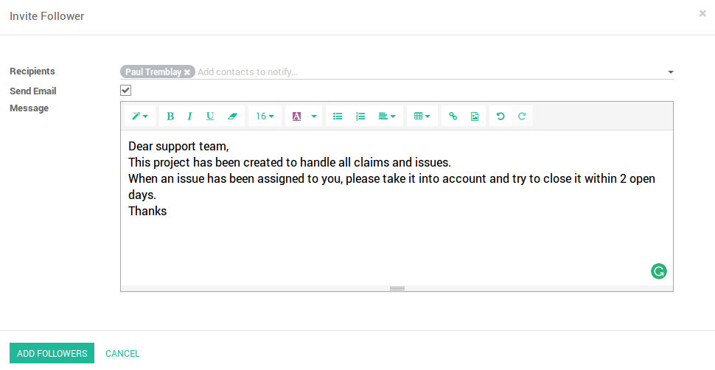
Issues assigned to employees
Adding a follower means that this person will be notified of any changes that might happen in the task.

Slide 38
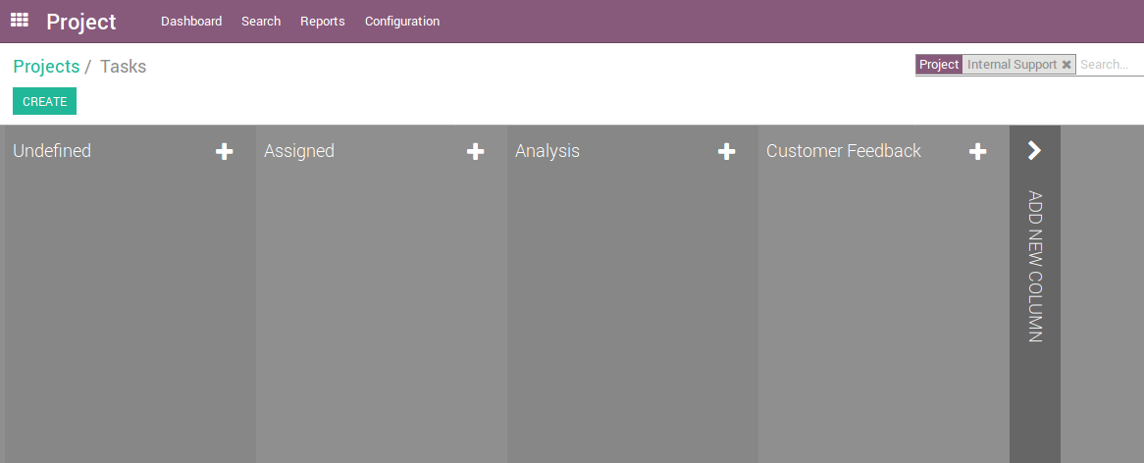
Set up the workflow

Slide 39
Document Management in tasks

Slide 40
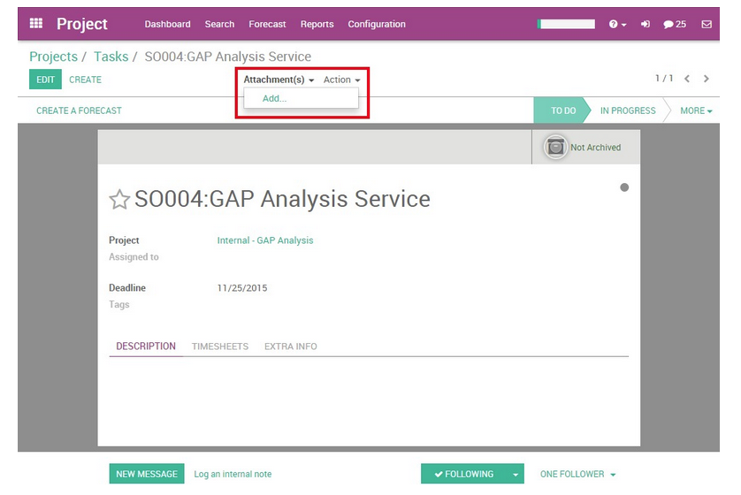
Document Management in Tasks
You can manage documents related to tasks whether they are plans, pictures of the formatting, etc. There are two ways to add a document to a task :
1. By clicking on the Attachment tab on the top of the form.
CC-BY-NC-SA

Slide 41
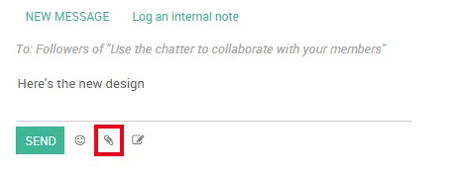
Document Management in Tasks
2. Through the Chatter, you can log a note/send a message and attach a file to it. Or if someone sends an email with an attachment, the document will be automatically saved in the task.
CC-BY-NC-SA

Slide 42
Questions?
CC-BY-NC-SA

Slide 43
Contributions
This document has been authored and distributed by the functional team of Odoo, Savoir-faire Linux :
Carolandrea Guerrero
Mickaël Brard
Marc Lijour
Julien Jézéquel-Bréard
Bruno Joliveau
Quentin Lavallée
Adriana Ierfino
Guillaume Lot
You can download this training document, use and modify it (within diposals and limits of the applicable licence CC-BY-NC-SA), at the following url : https://github.com/savoirfairelinux/training-odoo

Slide 44

IT Management Solutions

